Slide 1
Data Warehousing & Data Mining
Book1:
Data Mining Concepts & Techniques: Jiawei Han & Micheline-Morgan Kauffman Publication
Book2:
Data warehousing , Data mining & OLAP By: Berson & Smith -TMH

Slide 2
Units To Be Covered
Data warehousing
Data Preprocessing
Introduction to data mining
Association rule mining
Classification & prediction
Cluster analysis
Data mining cases
Data mining confidentiality

Slide 3
Unit-1
Data Warehousing

Slide 4
Topic to be covered in unit-1
Definition of data warehouse.
Characteristics of Data warehouse.
Benefit of data warehouse.
Need of separate data ware house.
OLAP & OLTP
Multi Dimensional Data Models
OLAP Operations
Data marts and type of Data marts

Slide 5
Topic to be covered in unit-1
Design of data warehouse
Process of data warehouse design
Tree tier data warehouse architecture.
Types of OLAP Servers
    ROLAP
    MOLAP
    HOLAP
Data were house backend tools & utility.

Slide 6
What is a Data Warehouse?
Defined in many different ways, but not rigorously.
  A decision support database that is maintained separately from the organization’s operational database
  Support information processing by providing a solid platform of consolidated, historical data for analysis.
“A data warehouse is a subject-oriented, integrated, time-variant, and nonvolatile collection of data in support of management’s decision-making process.”—W. H. Inmon
Data warehousing:-
  The process of constructing and using data warehouses

Slide 7
Data Warehouse—Subject-Oriented
Organized around major subjects, such as customer, product, sales
Focusing on the modeling and analysis of data for decision makers, not on daily operations or transaction processing
Provide a simple and concise view around particular subject issues by excluding data that are not useful in the decision support process

Slide 8
Data Warehouse—Integrated
Constructed by integrating multiple, heterogeneous data sources
  relational databases, flat files, on-line transaction records
Data cleaning and data integration techniques are applied.
  Ensure consistency in naming conventions, encoding structures, attribute measures, etc. among different data sources
    E.g., Hotel price: currency, tax, breakfast covered, etc.
  When data is moved to the warehouse, it is converted.

Slide 9
Data Warehouse—Time Variant
The time horizon for the data warehouse is significantly longer than that of operational systems
  Operational database: current value data
  Data warehouse data: provide information from a historical perspective (e.g., past 5-10 years)
Every key structure in the data warehouse
  Contains an element of time, explicitly or implicitly
  But the key of operational data may or may not contain “time element”

Slide 10
Data Warehouse—Nonvolatile
A physically separate store of data transformed from the operational environment.
Operational update of data does not occur in the data warehouse environment.
  Does not require transaction processing, recovery, and concurrency control mechanisms.
  Requires only two operations in data accessing:
    initial loading of data and access of data

Slide 11

Bill Inmon
William H. Inmon is an American computer scientist, recognized by many as the father of the data warehouse. Wikipedia
Born: July 20, 1945 (age 67), San Diego
Education: Yale University, New Mexico State University

Slide 12
Benefit /Usage of data warehouse.
Three kinds of data warehouse applications
  Information processing:-supports querying, basic statistical analysis, and reporting using crosstabs, tables, charts and graphs.
  Analytical processing
    multidimensional analysis of data warehouse data
    supports basic OLAP operations, slice-dice, drilling, pivoting
  Data mining
    knowledge discovery from hidden patterns
    supports associations, constructing analytical models, performing classification and prediction, and presenting the mining results using visualization tools.

Slide 13
Need of separate data ware house.
High performance for both systems
  DBMS— tuned for OLTP: access methods, indexing, concurrency control, recovery
  Warehouse—tuned for OLAP: complex OLAP queries, multidimensional view, consolidation
Different functions and different data:
  Missing data: Decision support requires historical data which operational DBs do not typically maintain
  Data consolidation: Decision Supports requires consolidation (aggregation, summarization) of data from heterogeneous sources
  Data quality: different sources typically use inconsistent data representations, codes and formats which have to be reconciled
Note: There are more and more systems which perform OLAP analysis directly on relational databases

Slide 14
OLTP vs. OLAP
 | OLTP | OLAP
users | clerk, IT professional | knowledge worker
function | day to day operations | decision support
DB design | application-oriented | subject-oriented
data | current, up-to-date detailed, flat relational isolated | historical, summarized, multidimensional integrated, consolidated
usage | repetitive | ad-hoc
access | read/write index/hash on prim. key | lots of scans
unit of work | short, simple transaction | complex query
# records accessed | tens | millions
#users | thousands | hundreds
DB size | 100MB-GB | 100GB-TB
metric | transaction throughput | query throughput, response

Slide 15
Note:-
Transactional throughput:-The speed of a database system is measured by the transaction throughput, expressed as a number of transactions per second.
Query Throughput (QthD) is a measurement used to determine the performance of a database system.

Slide 16
Multi Dimensional Data Models
A data warehouse is based on a multidimensional data model which views data in the form of a data cube,
A data cube, such as sales, allows data to be modeled and viewed in multiple dimensions
  Dimension tables, such as item (item name, brand, type), or time(day, week, month, quarter, year)
  Fact table contains measures (such as dollars_sold) and keys to each of the related dimension tables
In data warehousing literature, an n-D base cube is called a base cuboid. The top most 0-D cuboid, which holds the highest-level of summarization, is called the apex cuboid. The lattice of cuboids forms a data cube.

Slide 17
Cube: A Lattice of Cuboids
all
0-D (apex) cuboid
time
item
location
supplier
1-D cuboids
time,location
item,location
location,supplier
time,item
2-D cuboids
time,supplier
item,supplier
time,location,supplier
3-D cuboids
time,item,location
time,item,supplier
item,location,supplier
4-D (base) cuboid
time, item, location, supplier

Slide 18
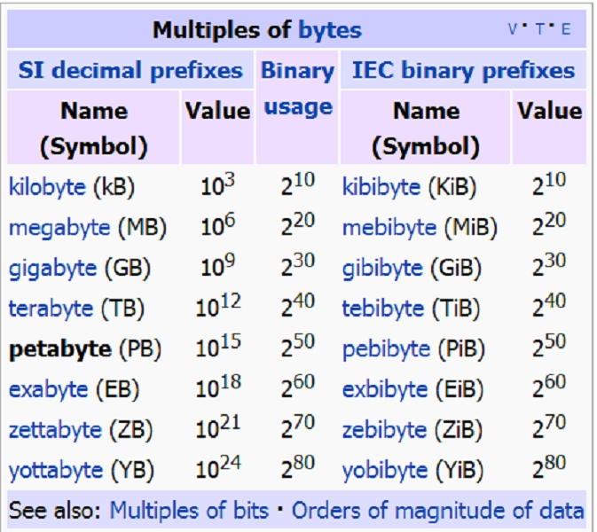
Multiples of Byte

Slide 19
OLAP Operations
Roll up (drill-up): summarize data
  by climbing up hierarchy or by dimension reduction
Drill down (roll down): reverse of roll-up
  from higher level summary to lower level summary or detailed data, or introducing new dimensions
Slice and dice: project and select
Pivot (rotate):
  reorient the cube, visualization, 3D to series of 2D planes
Other operations
  drill across: involving (across) more than one fact table
  drill through: complete the bottom level of the cube to its back-end relational tables (using SQL)

Slide 20
Data mart and types of data marts
What Is a Data Mart?:-A data mart is a simple form of a data warehouse that is focused on a single subject (or functional area), such as Sales or Finance or Marketing. Data marts are often built and controlled by a single department within an organization.
Given their single-subject focus, data marts usually draw data from only a few sources. The sources could be internal operational systems, a central data warehouse, or external data.

Slide 21
There are two approaches to data warehouse
Top-down data warehousing approach:-
According to W.H. inman first we need to build an enterprise data warehouse, and then from the enterprise data warehouse build a subject oriented database known as data marts
Bottom-up data warehousing approach:
According to Ralph Kimball first we need to develop a subject oriented database known as “data marts”, then integrate the data marts into data warehouse.

Slide 22
Data Warehouse Vs Data Marts
Data Warehouse
Data Marts
Scope
  Application independent
  Centralized or Enterprise
  Planned
Data
  Historical, detailed, summary
  Some demoralization
Subjects
  Multiple subjects
Source
  Many internal and external sources
Other
  Flexible
  Data oriented
  Long life
  Single complex structure
Scope
  Specific application
  Decentralized by group
  Organic but may be planned
Data
  Some history, detailed, summary
  High demoralization
Subjects
  Single central subject area
Source
  Few internal and external sources
Other
  Restrictive
  Project oriented
  Short life
  Multiple simple structures that may
  form a complex structure

Slide 23
Types of data marts
Dependent,
Independent,
Hybrid Data Marts

Slide 24
Dependent Data Marts
A dependent data mart allows you to unite your organization's data in one data warehouse. This gives you the usual advantages of centralization.
In a top-down data ware approach a data mart development is independent of enterprise data warehousing, such data marts are known as dependent data marts.

Slide 25
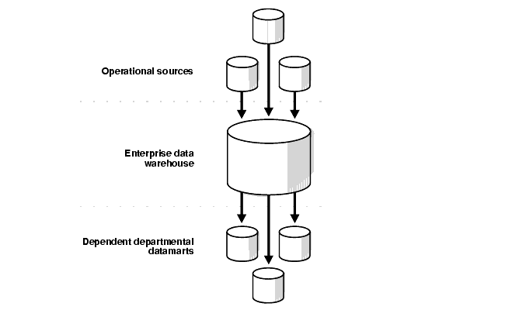
Dependent Data Marts

Slide 26
Independent Data Marts
An independent data mart is created without the use of a central data warehouse. This could be desirable for smaller groups within an organization.
In bottom-up approach a data mart development is independent of data warehouse. Such data marts are called ‘independent data marts’.

Slide 27
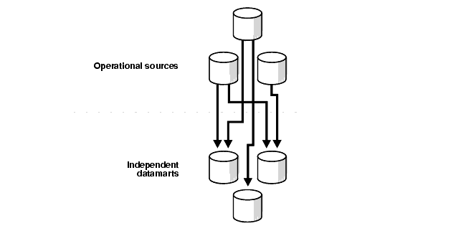
Independent Data Marts

Slide 28
Hybrid Data Marts
A hybrid data mart allows you to combine input from sources other than a data warehouse. This could be useful for many situations, especially when you need ad hoc integration, such as after a new group or product is added to the organization

Slide 29
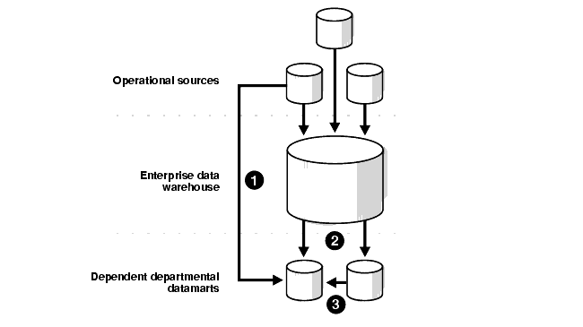
Hybrid Data Marts

Slide 30
Topic to be covered in unit-1
Design of data warehouse
Process of data warehouse design
Tree tier data warehouse architecture.
Types of OLAP Servers
    ROLAP
    MOLAP
    HOLAP
Data were house backend tools & utility.

Slide 31
Design of Data Warehouse: A Business Analysis Framework
Four views regarding the design of a data warehouse
  Top-down view
    Allows selection of the relevant information necessary for the data warehouse
  Data source view
    Exposes the information being captured, stored, and managed by operational systems
  Data warehouse view
    Includes the fact tables and dimension tables. It represents the information that is stored with in the data warehouse as well as information regarding the data, time of origin of the source data to provide the historical context.
  Business query view
    Sees the perspectives of data in the warehouse from the view of end-user

Slide 32
Data Warehouse Design Process
Top-down, bottom-up approaches or a combination of both
  Top-down: Starts with overall design and planning (mature)
  Bottom-up: Starts with experiments and prototypes (rapid)
From software engineering point of view
  Waterfall: structured and systematic analysis at each step before proceeding to the next
  Spiral: rapid generation of increasingly functional systems, short turn around time, quick turn around
Typical data warehouse design process
  Choose a business process to model, e.g., orders, invoices, etc.
  Choose the grain (atomic level of data) of the business process
  Choose the dimensions that will apply to each fact table record
  Choose the measure that will populate each fact table record

Slide 33
Typical data warehouse design process
Choose the business process to model, for example orders, invoices, shipments etc. If the business process is multiple and involves many parts of the organization a data warehouse model should be followed. On the other hand if the business process involves only one kind of process a data mart should be made.
Choose the grain of the business process. The grain is the fundamental atomic level at which a fact in a fact table is to be represented.
Choose the dimensions that will apply to each fact table record. Typical dimensions are time, item, customer, supplier, warehouse transaction type and status.

Slide 34
Typical data warehouse design process
Choose the measures that will populate each fact table record. Typical measures are numeric additive quantities like dollars sold and units sold.
Since data warehouse construction is a difficult and a long term task, its implementation scope should be clearly defined in the beginning. The goals of an initial data warehouse should be specific, achievable and measurable

Slide 35
Data Warehouse Development: A Recommended Approach
Multi-Tier Data Warehouse
Distributed Data Marts
Enterprise Data Warehouse
Data Mart
Data Mart
Model refinement
Model refinement
Define a high-level corporate data model

Slide 36
Data Warehouse: A Multi-Tiered Architecture
Monitor
&
Integrator
OLAP Server
Other
sources
Metadata
Analysis
Query
Reports
Data mining
Operational
DBs
Extract
Transform
Load
Refresh
Data
Warehouse
Serve
Data Marts
Data Sources
Data Storage
OLAP Engine
Front-End Tools

Slide 37
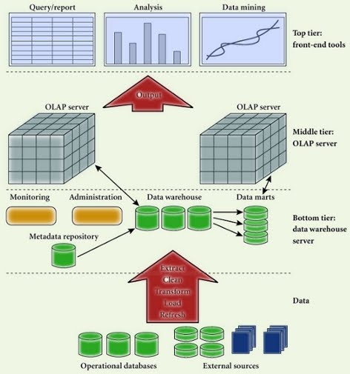

Slide 38
Three-tier data warehouse architecture
The bottom tiers is a warehouse database server that is almost always a relational database system. Data from operational databases and from external sources are extracted using application program interfaces known as gateways. A gateway is supported by the underlying DBMS and allows client programs to execute code.

Slide 39
Three-tier data warehouse architecture
The middle tier is an OLAP server that is typically implemented using a relational OLAP(ROLAP) model.
The top tier is a client, which contains query and & reporting tools, analysis tools and/or data mining tools.
From the architecture point of view there are three data warehouse models: the enterprise warehouse, the data mart, and the virtual warehouse.

Slide 40
Three Data Warehouse Models
Enterprise warehouse
  collects all of the information about subjects spanning the entire organization
Data Mart
  a subset of corporate-wide data that is of value to a specific groups of users. Its scope is confined to specific, selected groups, such as marketing data mart
    Independent vs. dependent (directly from warehouse) data mart
Virtual warehouse
  A set of views over operational databases
  Only some of the possible summary views may be materialized

Slide 41
Extraction, Transformation, and Loading (ETL)
Data extraction
  get data from multiple, heterogeneous, and external sources
Data cleaning
  detect errors in the data and rectify them when possible
Data transformation
  convert data from legacy or host format to warehouse format
Load
  sort, summarize, consolidate, compute views, check integrity, and build indices and partitions
Refresh
  propagate the updates from the data sources to the warehouse
Notes:
MK 08.11.09 Former title: Data Warehouse Back-End Tools and Utilities

Slide 42
Metadata Repository
Meta data is the data defining warehouse objects. It stores:
Description of the structure of the data warehouse
  schema, view, dimensions, hierarchies, derived data defn, data mart locations and contents
Operational meta-data
  data lineage (history of migrated data and transformation path), currency of data (active, archived, or purged), monitoring information (warehouse usage statistics, error reports, audit trails)
  The algorithms used for summarization
  The mapping from operational environment to the data warehouse
  Data related to system performance
    warehouse schema, view and derived data definitions
Business data
  business terms and definitions, ownership of data, charging policies

Slide 43
Types of OLAP Servers
Normally business users are presented with Multidimensional data from data warehouses or data marts without them being aware of the way in which i. e. how or where the data are stored. However, the physical architecture and implementation of OLAP servers need to take into consideration the issues regarding data storage.
So there are three types of OLAP Servers .
  Relational OLAP(ROLAP)servers:
  Multidimensional OLAP (MOLAP) servers
  Hybrid OLAP (HOLAP) servers:

Slide 44
http://www.cs.washington.edu/education/courses/csep573/01sp/lectures/class1/sld027.htm

Slide 45
  Relational OLAP(ROLAP)servers:
These are intermediate servers that stand in between a relational back-end server and client front-end tools.
They use a relational or an extended relational DBMS to store and manage warehouse data, OLAP middle ware to support missing pieces.

Slide 46
Multidimensional OLAP (MOLAP) servers:
These servers support multidimensional view of data through array based multi dimensional storage engines.
They map multidimensional views directly to data cube array structures.

Slide 47
Hybrid OLAP (HOLAP) servers:
The hybrid OLAP approach combines ROLAP and MOLAP technologies providing greater scalability and faster computation of MOLAP.
For example, a HOLAP server may allow large volumes of data to be kept in a relational database and aggregations to be kept in separate MOLAP store.

Slide 48
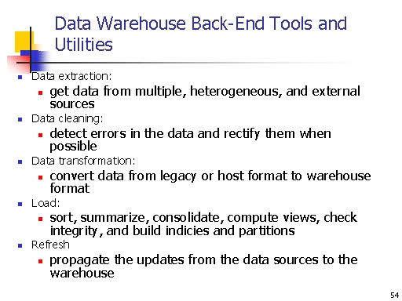

Slide 49
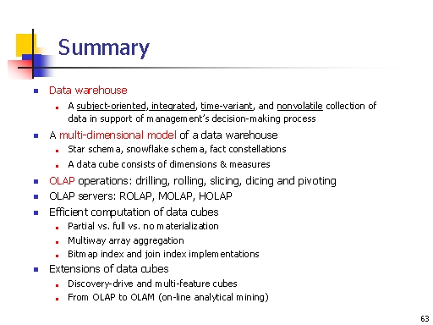

Slide 50
http://www.cs.washington.edu/education/courses/csep573/01sp/lectures/class1/sld027.htm

